Slide 1
What is smartcity?
A smart city is an urban development using Information and Communication Technology (ICT) and Internet of Things (IoT) to provide useful information to effectively manage resources and assets. This includes data collected from citizens and mechanical devices, that are processed and analyzed to monitor and manage traffic and transport systems, power plants, water supply networks, waste disposal, etc.
Also called eco-city or sustainable city, the smart city aims to improve the quality of urban services or reduce its costs. It stands out for its specificities: smart management, lifestyle, mobility, housing, as well as a smart economy. Their main goal is to reconcile technological innovation with the economic, social and ecological challenges of the city of tomorrow. Their leitmotiv is the quality of life: how to live better together while respecting our environment.

Slide 2
Who invented the smart city?
Image result
The origin
The concept of smart cities originated at the time when the entire world was facing one of the worst economic crises. In 2008, IBM began work on a 'smarter cities' concept as part of its Smarter Planet initiative.15-Aug-2014

Slide 3
Benefits of smart cities
. Environmental impact
Reducing the CO2 footprint is the main driver behind the development of smart and sustainable cities. Improving energy efficiency and storage, waste management, traffic conditions are among the greatest advantages.
2. Optimized energy & water management
Smart grids and smart water management are recurring themes of smart cities. Energy consumption and potable water monitoring ensure the availability of energy and the quality of tap water across the city.

Slide 4

3. Transportation Clean and efficient transportation of goods, services and people is essential. In the hope of optimizing mobility, many cities are turning to smart technologies to ease traffic congestion and provide users with real-time updates.
4. Security
Safety is a priority for all cities. The accelerated development of smart cities should allow municipalities to better monitor their citizens thanks to CCTV cameras with facial recognition. In addition, state-of-the-art CCTV cameras are also equipped with motion and smoke detectors, as well as fire alarms.

Slide 5
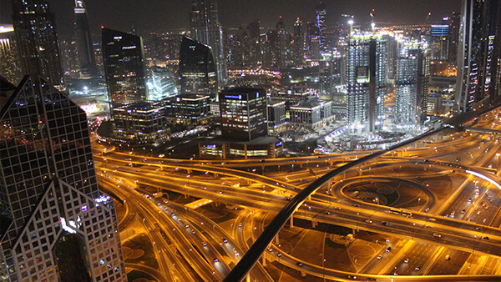

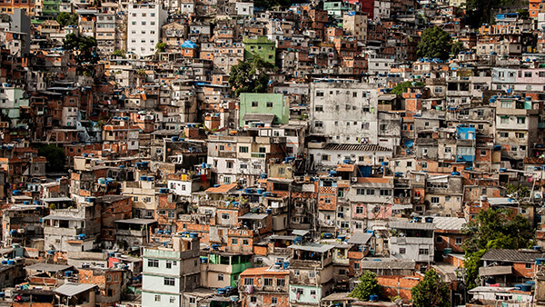
Smart citie challenges
INFRASTRUCTURE AND COSTS
Smart cities use sensor technology to gather and analyze information such as rush hour stats, air quality or crime rates. The implementation of these sensors requires a sophisticated and costly infrastructure.
SECURITY AND PRIVACY CONCERNS
Even though security is part of the benefits, it can also be regarded as a challenge as the use of IoT and sensor technology increases. In fact, the threat of cyber attacks is a critical issue for smart cities. Also, to avoid concerns about data use, smart cities need to involve their citizens. Awareness, education, and transparency on the purpose of data collection are crucial to make the community feel that they are truly taking part in making their city more sustainable.
SOCIAL RISKS
inclusive urbanization must be a priority to deal with the increasing vulnerability of poor and slum populations. That is why we need to ensure that no population is excluded from smart city data collection and use.

Slide 6
Smart cities technologies
1. Smart buildings
The optimisation of services like heating, ventilation, and air conditioning (HVAC), as well as energy usage and efficiency, is crucial. Building-integrated photovoltaics are a great solution of smart building management.
2. Smart mobility
Promoting electric vehicles, self-service bikes, public transport and carpooling networks, as well as providing charging stations must be a priority, to give city dwellers true sustainable alternatives to the single-occupant fossil fuelled car.

Slide 7
Smart lighting
Lighting optimization aims at reducing energy usage of the lighting systems, by providing the correct amount of light at the correct time with efficient fixtures. Intelligent and weather adaptive streetlights are a good example of smart lighting systems.
Smart roads
Control sensors can be used to monitor certain traffic patterns and common traffic jams. Besides, smart technologies can detect the possible deterioration of equipment such as traffic lights and light panels for pedestrians, or the effect of traffic on the environment.

Slide 8
Why is smart city important?
Smart cities are designed for optimum usage of space and resources along with an efficient and optimum distribution of benefits. It also aims at increasing connectivity at various levels among citizens, as well as between the administration and population.

Slide 9
What are smart city features?
The core infrastructure elements in a Smart City would include - adequate water supply, assured electricity supply, sanitation, including solid waste management, efficient urban mobility and public transport, affordable housing, especially for the poor, robust IT connectivity and digitalization, good governance, .

Slide 10
How do Smart cities work?
A smart city is an intelligent city that integrates digital technologies into its networks, services and infrastructure. It means smart urban transportation networks, upgraded water supply and waste disposal facilities and more efficient ways to light and heat buildings.
What is the future of smart cities?
Smart cities offer better use of space, less traffic, cleaner air, and more efficient civic services, all of which increases quality of life. What's more, smart cities provide more career and economic opportunities as well as stronger links with the community.

Slide 11
What are the components of smart city?
Image result
Four Components to a Smart City
Analytics: Putting Data to Work. Data lies at the heart of the smart city. ...
Transportation: Smart Transportation Solutions. ...
Health: Building Healthier Communities. ...
Environment: Creating Resilient Urban Environments. ...
Bringing It All Together.

Slide 12
What are the four pillars of smart city?
Smart city is envisaged to have four pillars, its Social Infrastructure, Physical Infrastructure, Institutional Infrastructure (including Governance) and Economic Infrastructure. The centre of attention for each of these pillars is the citizen.
How a smart city will improve human life?
Smart cities put data and digital technology to work to make better decisions and improve the quality of life. More comprehensive, real-time data gives agencies the ability to watch events as they unfold, understand how demand patterns are changing, and respond with faster and lower-cost solutions

Slide 13
What are the limitations of smart city?
Disadvantages of Smart Cities
Lack of public awareness and social responsibility.
Building and maintaining the infrastructure is costly and challenging.
Demands 24X7 connectivity and power supply.
Security issues in terms of public data.
May lead a way towards social discrimination.

Slide 14
What are the limitations of smart city?
Disadvantages of Smart Cities
Lack of public awareness and social responsibility.
Building and maintaining the infrastructure is costly and challenging.
Demands 24X7 connectivity and power supply.
Security issues in terms of public data.
May lead a way towards social discrimination.

Slide 15
What problems are solved by smart cities?
Smart Cities seek to improve people's lives in such basic areas as policy efficiency, reducing waste and everyday problems, improving social and economic quality, and maximising the social inclusion of their inhabitants
Which is the best smart city in the world?
Singapore Singapore consistently tops the list of the world's smartest cities no matter how they are rated. It was the only city in the top ten of the IMD's rankings not to move position from 2020 to 2021 – an indication of the city's commitment to smart technology.

Slide 16
What a smart city looks like?
According to our definition a smart city is a city that meets its specific challenges with digital and cross-sector solutions. For the purposes of sustainable development, information and communication technologies are used to improve urban processes and services in terms of public service and sustainability
How did smart city start?
Image result
The journey to smart cities goes way back to the 1970s, when Los Angeles created the first urban big data project: “A Cluster Analysis of Los Angeles”. The first smart city was arguably Amsterdam with the creation of a virtual digital city in 1994.

Slide 17
Do we need smart cities?
Yes – Smart cities are required.
The information will be collected through the detectors – gas, electricity and other government analytics, which will be carefully complied into small grids and then, will be fed into the computers. This process can focus on making the city efficient. 2.

Slide 18
What is the need of smart city in India?
In response to rapid urbanization, the Government of India launched the National Smart Cities Mission in 2015 for urban renewal – to retrofit 100 cities and make them sustainable by 2023. The agenda included addressing citizen services, clean air, housing, safety, power, water, sanitation and mobility.

Slide 19
What are the things that makes a smart city successful?
Support communication and improved transparency between citizens and the city through open data. Enable cross-departmental collaboration within governments. Provide rich contextual data to help inform decisions. Analyze the community to better understand its citizens and their unique needs.

Slide 20
What are two advantages of smart city?
Thinking about becoming a smart city? 10 benefits of smart cities
More effective, data-driven decision-making. ...
Enhanced citizen and government engagement. ...
Safer communities. ...
Reduced environmental footprint. ...
Improved transportation. ...
Increased digital equity. ...
New economic development opportunities. ...
Efficient public utilities.

Slide 21
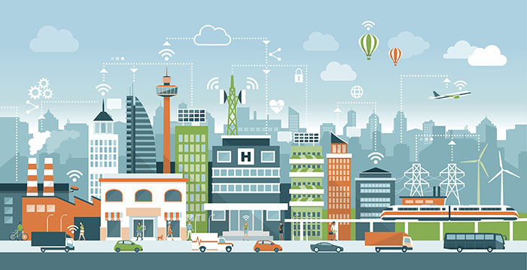

Slide 22
Why do we need smart cities?
Urbanization is a non-ending phenomenon.
Today, 54% of people worldwide live in cities, a proportion that’s expected to reach 66% by 2050.
With the overall population growth, urbanization will add another 2.5 billion people to cities over the next three decades.
Environmental, social, and economic sustainability is a must to keep pace with this rapid expansion taxing our cities’ resources.
One hundred ninety-three countries agreed upon the Sustainable Development Goals (SDGs) agenda in September 2015 at the United Nations.
But we all know how centralized decisions and actions can take time, and the clock is ticking.
The good news?
Citizens and local authorities are certainly more agile to launch swift initiatives, and smart city technology is paramount to success and meeting these goals.
​What is a smart city

Slide 23
How is IoT technology making cities smarter and better?
Secure wireless connectivity and IoT technology are transforming traditional elements of city life - like streetlights - into next-generation intelligent lighting platforms with expanded capabilities.
The scope includes integrating solar power and connecting to a cloud-based central control system that connects to other ecosystem assets.
These solutions shine far beyond simple lighting needs.
High-power embedded LEDs alert commuters about traffic issues, provide severe weather warnings, and provide heads up when fires arise, for example.
Streetlights can also detect free parking spaces and EV charging docks and alert drivers where to find an open spot via a mobile app. Charging might even be able from the lamppost itself in some locations!
Exciting stuff!
But how does it all fit together?

Slide 24
What makes smart cities successful
In addition to people, dwellings, commerce, and traditional urban infrastructure, there are four essential elements necessary for thriving smart cities:
Pervasive wireless connectivity
Open data
Security you can trust in
Flexible monetization schemes

Slide 25
What’s the best wireless technology for smart cities?
The first building block of any smart city application is reliable, pervasive wireless connectivity.
While there’s no one-size-fits-all, evolving Low Power Wide Area Network (LPWAN) technologies are well suited to most smart city applications for their cost efficiency and ubiquity.
These technologies include LTE Cat M, NB-IoT, LoRa, Bluetooth, and a few others that all contribute to the fabric of connected cities.
The advent of 5G technology is expected to be a watershed event that propels smart city technology into the mainstream and accelerates new deployments.
But only with a few more elements…

Slide 26
Can smart cities be secured and trusted?
In digital cities, connected cameras, intelligent road systems, and public safety monitoring systems can provide an added layer of protection and emergency support to aid citizens when needed.
But what about protecting smart cities themselves from vulnerabilities?
How can we defend against hacking, cyber-attacks, and data theft?
In cities where multiple participants share information, how do we trust that participants are who they say they are?
And how do we know the data they report is true and accurate?
The answers lie in physical data vaults and strong authentication and ID management solutions.
Smart cities can only work if we can trust them.

